Slide 1


Multiple Linear Regression: Baseball Example in Python
Wake Forest
School of Business
_______
BAN 7001

Slide 2
Baseball Salaries
Suppose that you are the manager for a major league baseball player, and you are preparing for the next round of salary negotiations. You have some historical data that includes the “stats” for several major league baseball players along with other information such as the number of years they’ve been playing, their team, league, and position.
You would like to develop a multiple linear regression model that will help you predict the expected salary for your player based on his stats from last season and his career performance.
Your analysis can be done in Excel, but you would like to use R since it is a more powerful tool for predictive modeling.

Slide 3
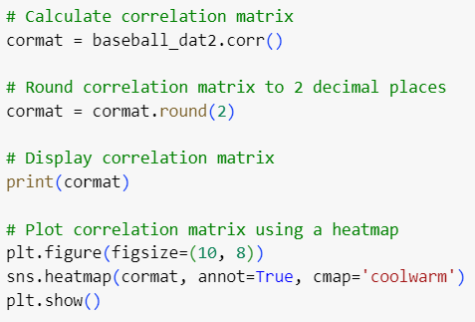
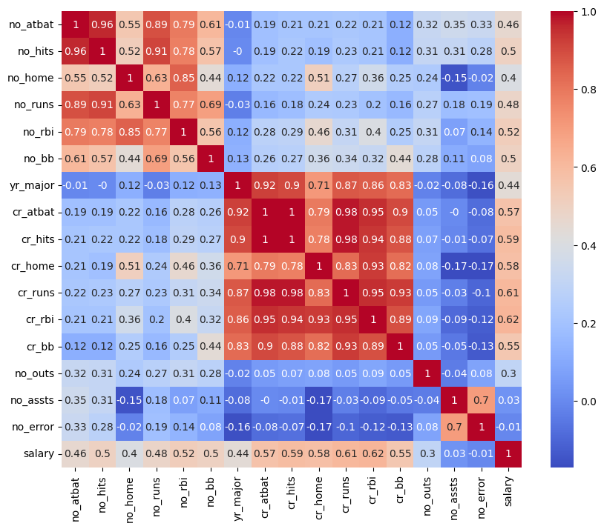

Exploratory Analysis

Slide 4
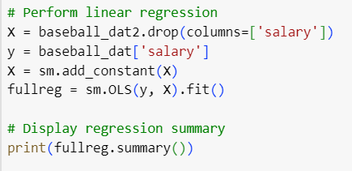
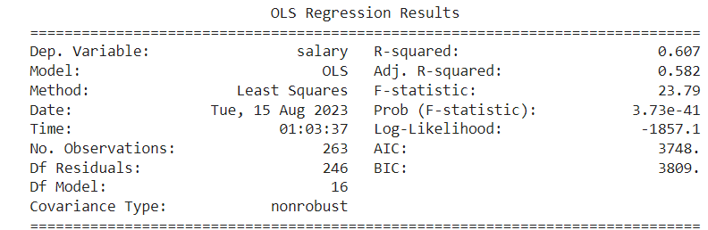
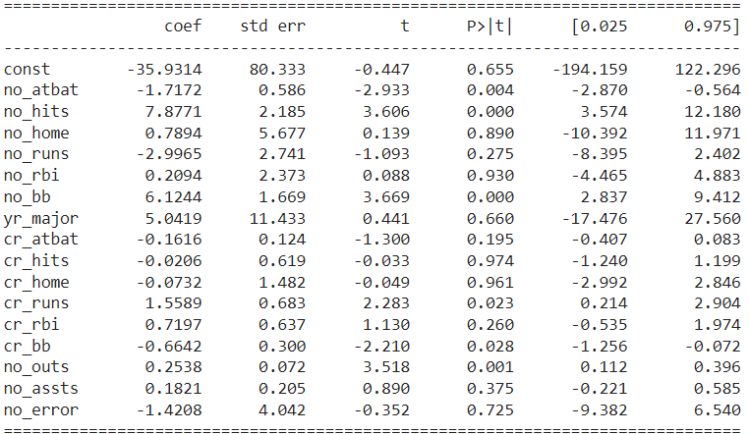
Full Model

Slide 5
Full Model

Slide 6
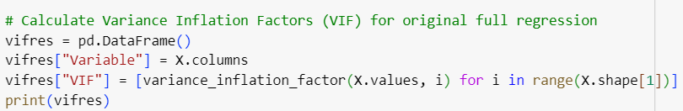
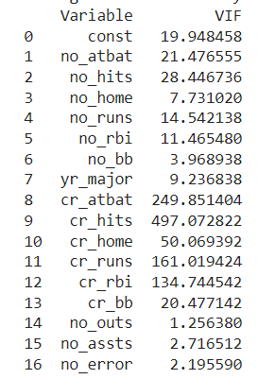
Variance Inflation Factor (VIF)

Slide 7
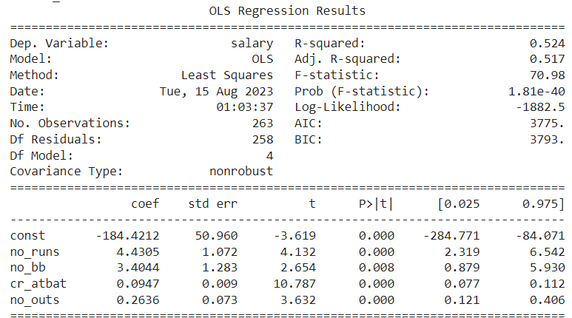
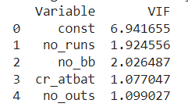
Reduced Model

Slide 8
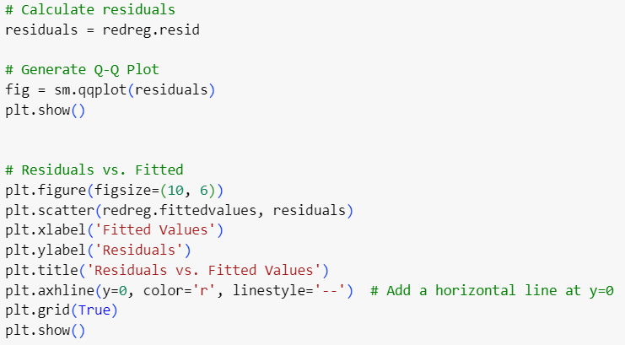
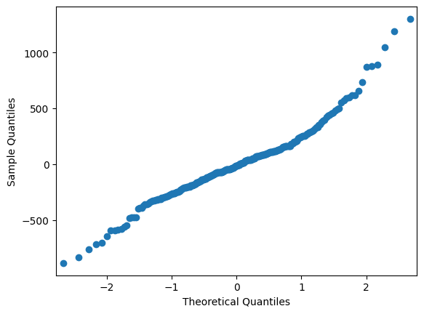
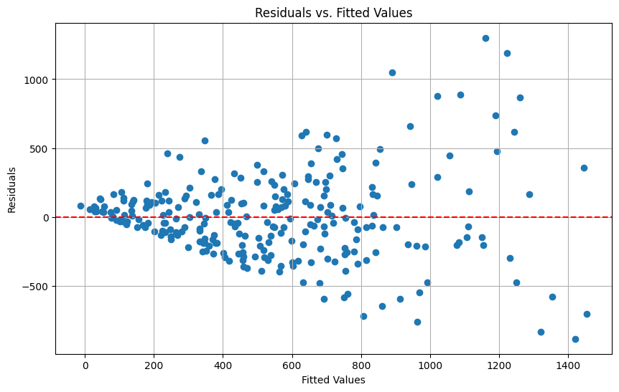
Residual Plots

